Slide 1
Education in CR, UK, USA

Slide 2
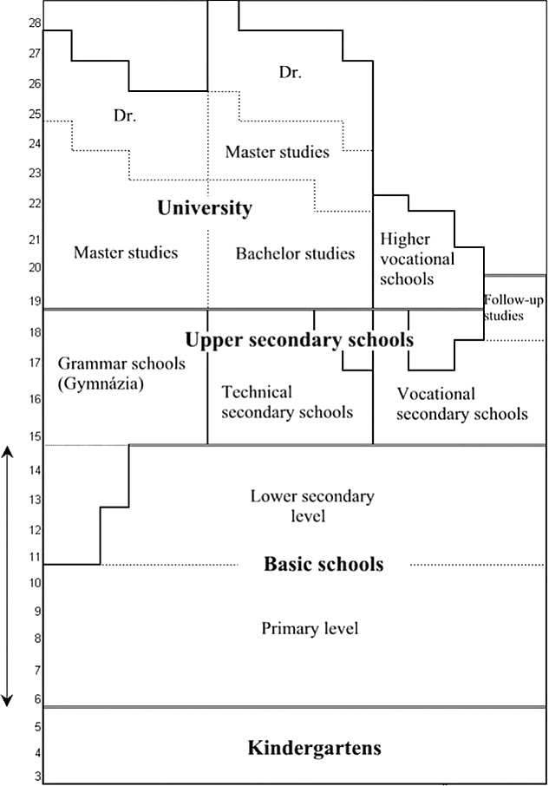
The Czech Republic
How long is compulsory education?
10 years (1 year of kindergarten)
Which subjects are taught at primary/lower secondary level?
Czech, Maths, English + 2nd language, Biology, Geography, History, Social Sciences, Music, Art, Physical Education, IT…
Which types od secondary schools do you know?
grammar school
technical schools (of civil, mechanical, electrical, textile engineering), medical/health care, economy, arts…
vocational schools
Which subjects does "maturita" (= school leaving exam) consist of?
Czech, Maths OR a foreign language + subjects connected to the type of school students study
Elementary schools

Slide 3
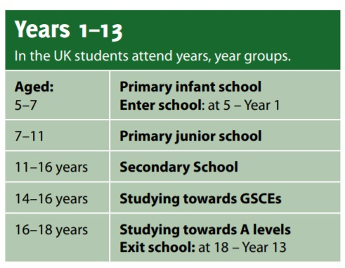
The United Kingdom
state x public (independent, private) schools
Compulsory education: age 5–16
GCSE: 8–9 subjects (at the age of 16)
= General Certificate of Secondary Education)
A-levels: 3–4 subjects (at the age of 18)
Tertiary level – study for a degree, college (more technically focused)/ university (pay for tuition)

Slide 4
GCSEs example questions
Economics
Is it ethical for developing countries, such as China, to aim for rapid economic growth?
Geography
For a hot desert environment or cold environment you have studied, to what extent does that environment provide both opportunities and challenges for development?
Media Studies
People working behind the scenes in media production need to be creative. Give an example of a media production role and explain two different ways this role needs creativity.

Slide 5
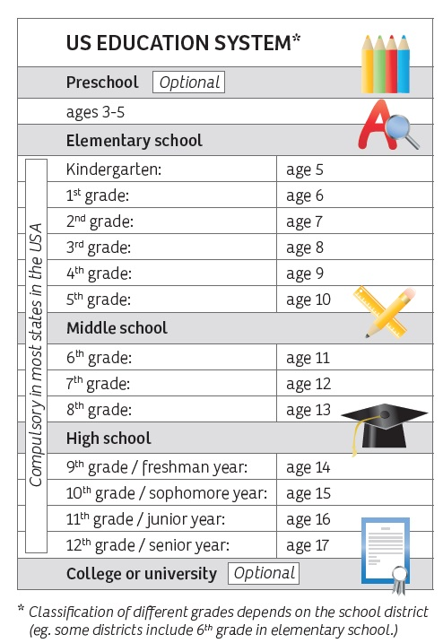
The United States of America
federal laws all states have to follow X local laws different in each state
Compulsory education: 12 grades (5 -17)
High school: choice of subjects and level of subjects (academic + vocational)
Grade 11: SAT test (= Scholastic Aptitude Test - language, writing, maths, critical thinking …), part of admitance policy to university
End of grade 12: high school diploma + graduation ceremony

Slide 6
povinný
volitelný
školní docházka
základní škola
střední škola
gymnázium
střední odborná škola
učiliště
učeň
obchodka
umělecká škola
přijímací zkoušky
maturita
compulsory
optional/voluntary
school attendance
primary/elementary
secondary/high/middle
grammar school
secondary technical school
vocational school
apprentice
school of commerce
art school
entrance exams
school leaving exan
dělat zkoušky – udělat zkoušky
dosáhnout
hlásit se na (univerzitu)
školka/jesle
školné
semestr/pololetí
vysvědčení
humanitní předměty
přírodovědné předměty
diplomová práce
titul
titul bakalář
titul magistr
titul inženýr
take – pass
achieve
apply for
kindergarten/nursery
tuition fee
term
school report
arts
sciences
diploma thesis
degree
Bachelor‘s degree
Master‘s degree
Engineer‘s degree

